Slide 1
VPA (VERS Processing Application) What, why, how
Andrew Waugh, PROV

Slide 2
What is the VPA?
VERS Processing Application
The VPA does all the VERS processing in the new digital archive
Validates the VEOs on ingest
Pulls information out of the VEOs for other modules on ingest and access

Slide 3
Why do we need the VPA?
To concentrate all VERS knowledge in the new Digital Archive in one place
This is a GOOD thing™
Don’t have to modify any other components to know about VERS
Focus VERS maintenance in one place

Slide 4
Where does it sit in the new system?
VPA
VEOS
Digital Archive System (DAS)
DSS
AMS
SAMS
IDAMS
Web FE
User Requests

Slide 5
What will the VPA be used for?
Ingest of new V2 and V3 VEOs
Migration of V2 VEOs from the existing Digital Archive
Access to closed digital records
Opening of closed digital records

Slide 6
What does the VPA actually do?
Unpacks the VEO
Assigns persistent identifiers to the VEO and each record item in the VEO
Calls the V2 or V3 validation software and reports any error messages
Builds packages of information for
AMS (common contextual metadata)
SAMS (content files for open records)
DAS (the actual VEO)

Slide 7
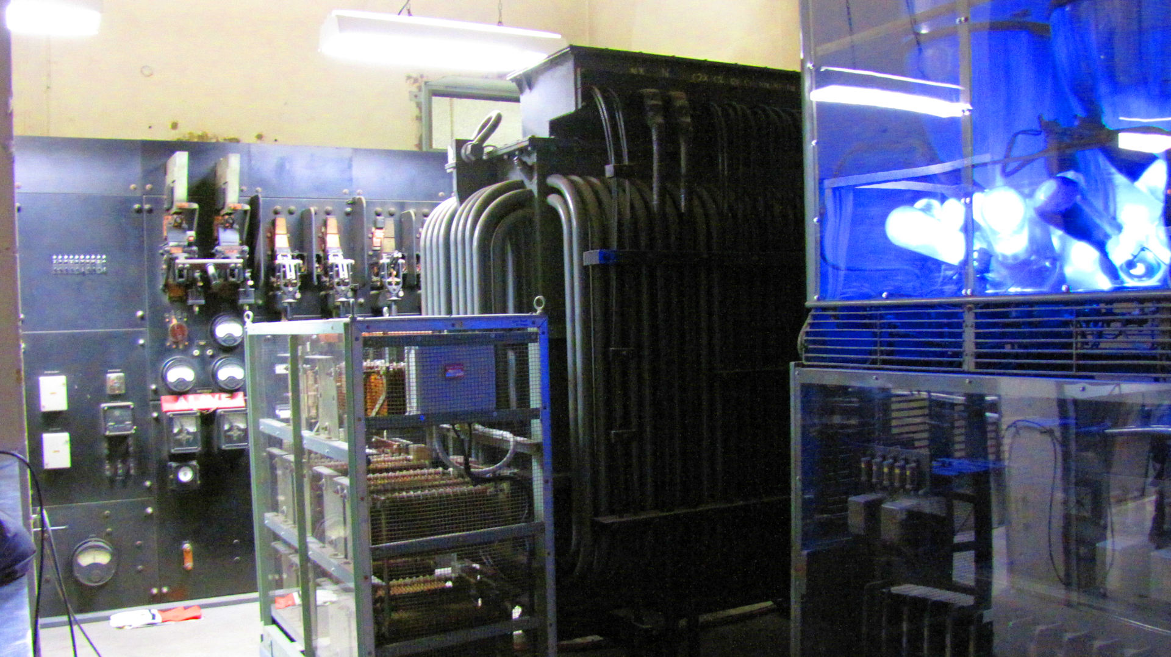
Let’s see it working….

Slide 8
How does it work with the system?
Ingest of new V2 and V3 VEOs
Migration of old V2 VEOs
Access to closed records

Slide 9
Ingest of new V2/V3 VEOs (1)
VPA
VEOS
Digital Archive System (DAS)
DSS
Sets of VEOs are ingested into the DAS
AMS
SAMS
IDAMS
Web FE
User Requests

Slide 10
Ingest of new V2/V3 VEOs (2)
VEOs are fed one at a time to the VPA, where they are validated and information pulled out to form packages for the other modules
VPA
VEOS
Digital Archive System (DAS)
DSS
AMS
SAMS
IDAMS
Web FE
User Requests

Slide 11
Ingest of new V2/V3 VEOs (3)
VPA
VEOS
Digital Archive System (DAS)
DSS
AMS
SAMS
The packages are returned to the DAS, and then fed to the DSS, AMS, and (if open) the SAMS
IDAMS
Web FE
User Requests

Slide 12
Access to Open Records
The Web front end accesses the AMS and SAMS for digital records that are open
VPA
VEOS
Digital Archive System (DAS)
DSS
AMS
SAMS
IDAMS
Web FE
User Requests

Slide 13
Access to closed records (1)
The Web front end asks IDAMS if the user can access this record
VPA
VEOS
Digital Archive System (DAS)
DSS
AMS
SAMS
IDAMS
Web FE
User Requests

Slide 14
Access to Closed Records (2)
VPA
VEOS
Digital Archive System (DAS)
DSS
AMS
If yes, the Web front end asks the DAS to retrieve the record
SAMS
IDAMS
Web FE
User Requests

Slide 15
Access to closed records (3)
VPA
VEOS
Digital Archive System (DAS)
DSS
AMS
The DAS retrieves the VEO from the DSS
SAMS
IDAMS
Web FE
User Requests

Slide 16
Access to closed records (4)
VPA
VEOS
Digital Archive System (DAS)
DSS
AMS
SAMS
The DAS sends the VEO to the VPA for reprocessing (building the SAMS package)
IDAMS
Web FE
User Requests

Slide 17
Access to closed records (5)
VPA
VEOS
Digital Archive System (DAS)
DSS
The DAS extracts the requested content and sends it to the Web front end (as if it was the SAMS), which sends it to the user
AMS
SAMS
IDAMS
Web FE
User Requests

Slide 18
Who is building the VPA?
We are
Why?
This is the low risk and low cost approach
PROV has expertise in VERS (the vendors do not)
We can evolve the VPA as the other modules are developed
It means that we have the knowledge to maintain the VPA in the future

Slide 19
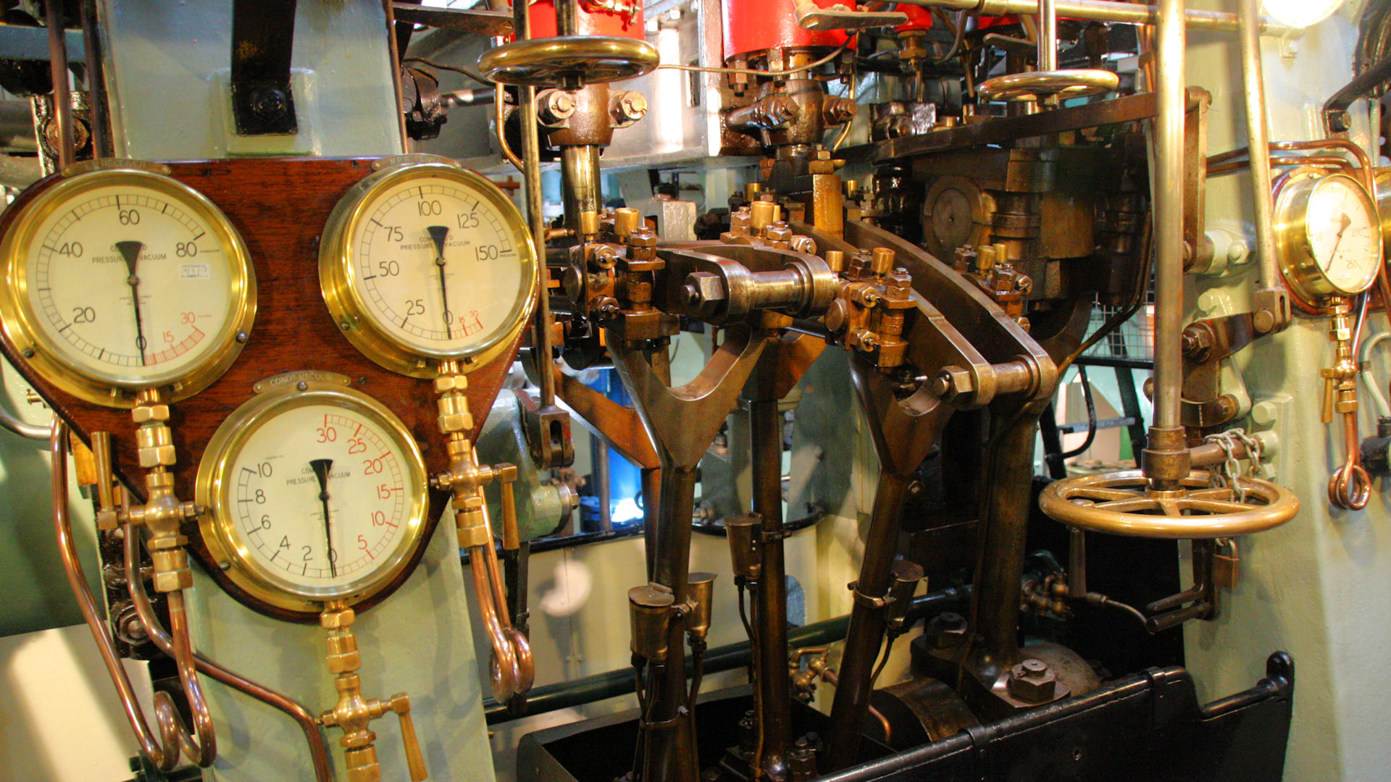
Any questions?

